Slide 1
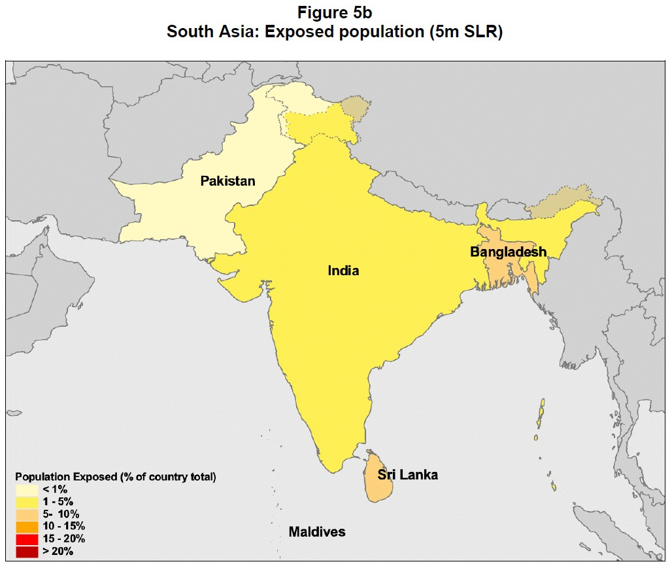
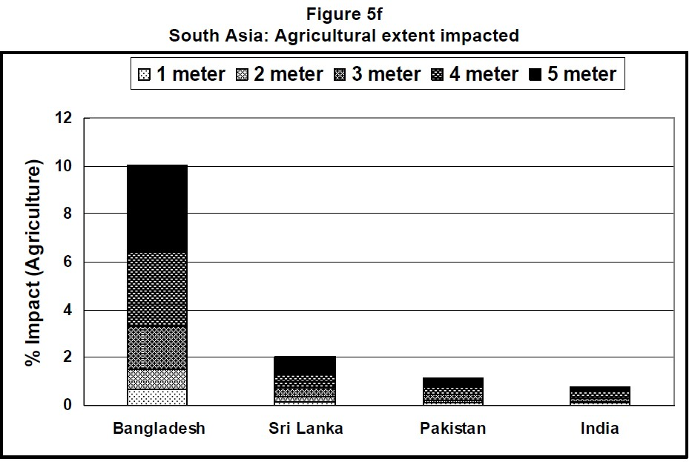
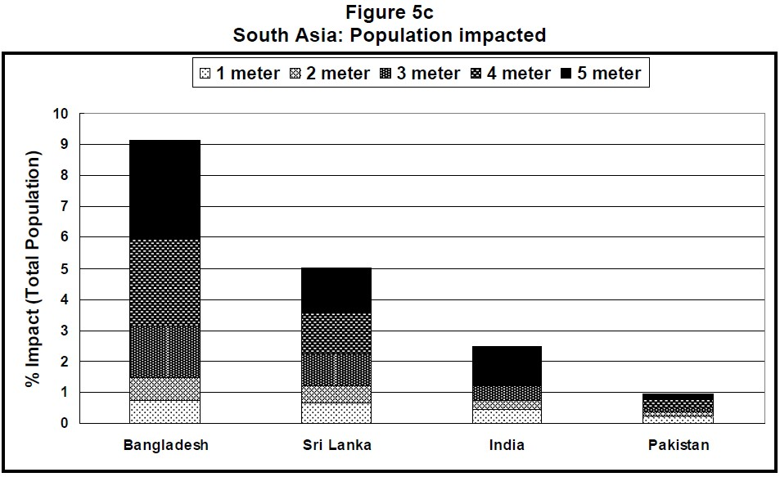
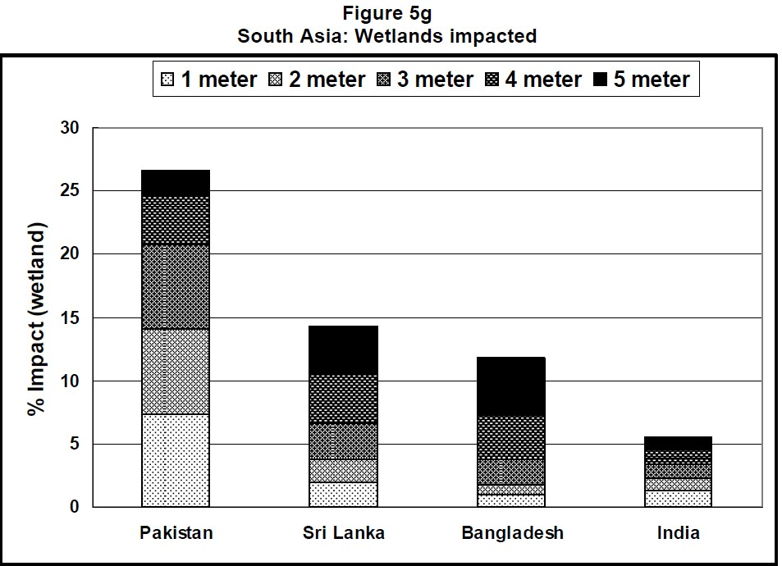
The Impact of Sea Level Rise on Developing Countries:
A Comparative Analysis
By
Susmita Dasgupta*
Benoit Laplante**
Craig Meisner*
David Wheeler***
and
Jianping Yan**
Sea-level Rise in a 2007 Research report which featured Bangladesh. Report detailed impact that future sea-level rise would have on population, agriculture, and wetlands
World Bank Policy Research Working Paper 4136, February 2007

